Slide 1
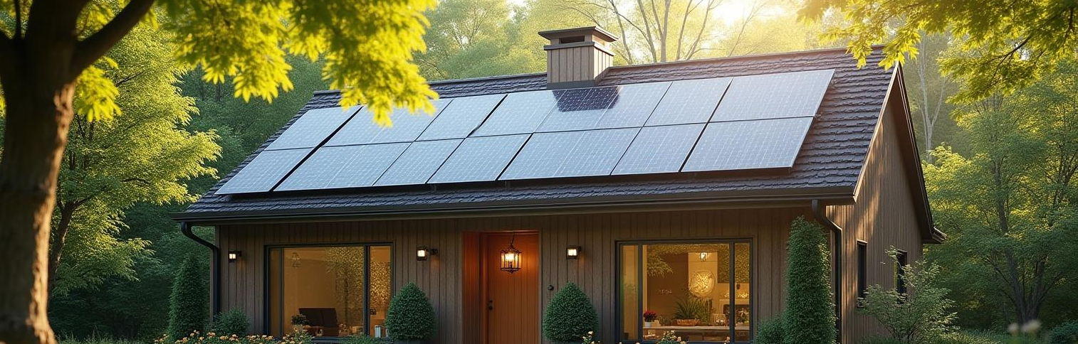
Green Home Loan 🌿🏡
A Smart Step Toward a Greener Future!

Slide 2
Introduction
Let's explore the Green Home Loan, designed to help our customers make eco-friendly choices.
We'll uncover its benefits, how it aligns with market trends, and engage the team in selling strategies.
This presentation aims to give you the tools and information needed to promote this exciting new product effectively.

Slide 3
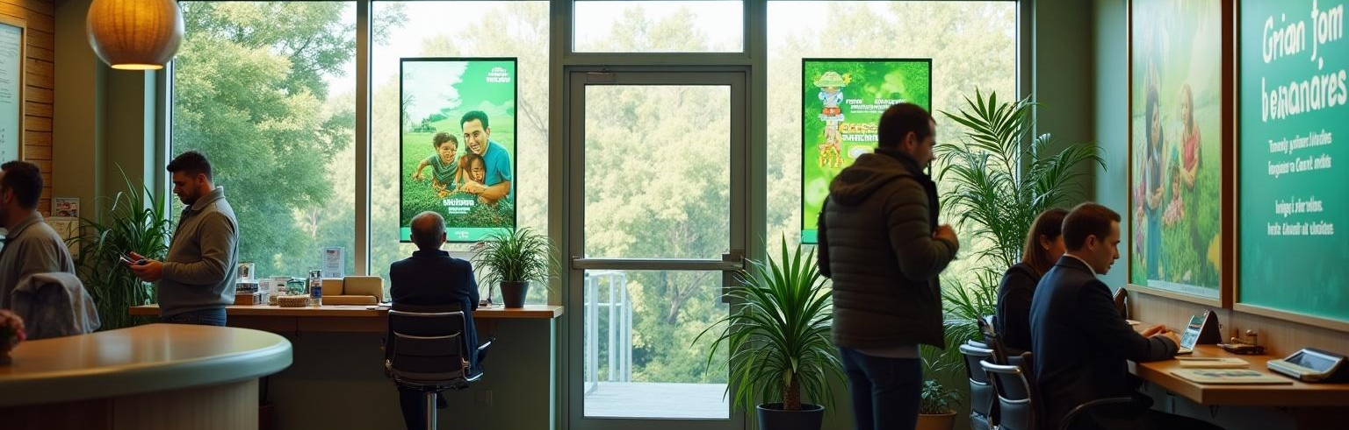
01
Topic 1: Understanding Green Home Loan

Slide 4
Why Green?
Rising eco-awareness and climate change concerns are prompting a shift towards sustainable living.
By investing in green homes, customers save on utilities and contribute to a positive environmental impact.
There's a growing interest in eco-living, making it a perfect time to introduce a product that supports this lifestyle.

Slide 5
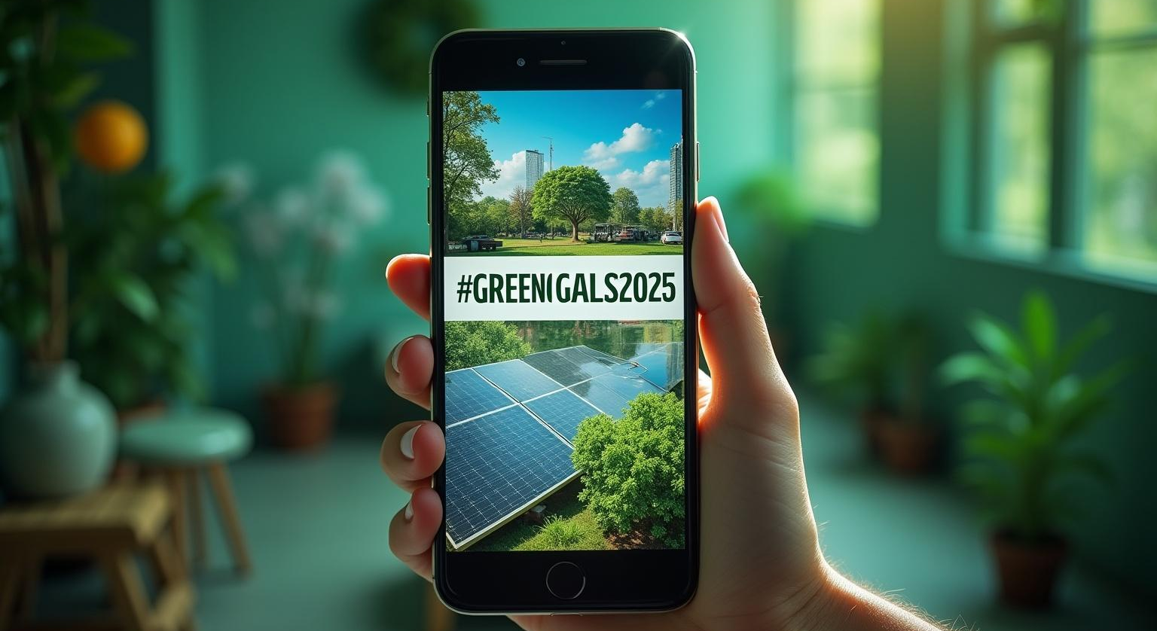
Product Overview
The Green Home Loan offers lower interest rates for eco-friendly houses.
It covers necessary upgrades like solar panels, insulation, and smart home technology, making eco-living accessible.
The application process is straightforward, with fast approval to get your customers on their way to a greener home.

Slide 6
Target Customers
The Green Home Loan is perfect for young families looking to create a sustainable home.
Eco-conscious individuals will appreciate the financial benefits of energy-efficient living.
Real estate buyers who want to build or renovate green homes will be major targets for this product.

Slide 7
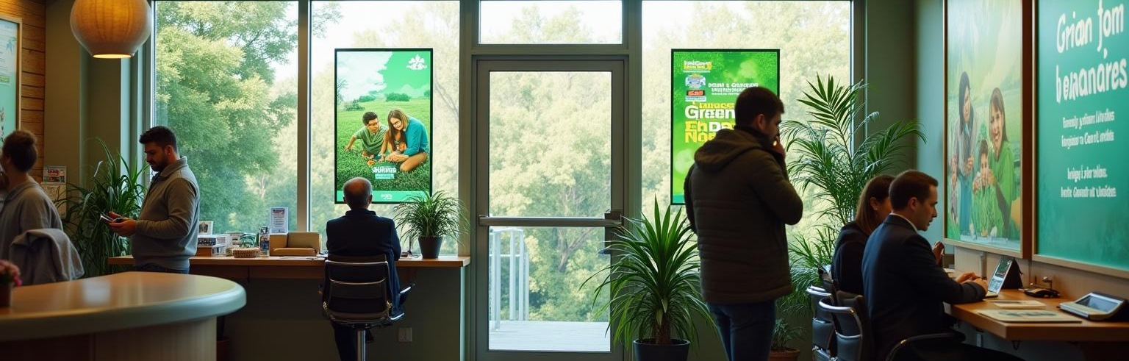
02
Topic 2: Sales and Marketing Strategy

Slide 8
How to Sell It
Focus on the customer benefits like comfort, savings, and healthier living environments.
Share personal stories to make the product relatable and use simple comparisons.
Emphasize the long-term cost efficiency of green homes, making sure customers see the value.

Slide 9
Marketing Strategy
Launch a social media campaign with the hashtag #GreenGoals2025 to engage eco-minded audiences.
Utilize eye-catching posters and digital signage in bank branches to attract attention.
Consider webinars or partnerships with influencers in the green living space to spread the word effectively.

Slide 10
Revenue & Growth Potential
More customers adopting the Green Home Loan leads to significant cross-selling opportunities.
This product can enhance our brand image as a sustainable bank, attracting more eco-conscious clients.
Incentives for high-performing sales teams can drive enthusiasm and increase productivity around this product.

Slide 11
Conclusions
The Green Home Loan represents a fantastic opportunity for us to contribute to sustainability.
By understanding our target audience and embracing effective strategies, we can position ourselves as leaders in eco-friendly banking.
Let’s get excited about this change and inspire our customers to join us on this green journey!

Slide 12
Thank you!
Do you have any questions?
+00 000 000 000

